Slide 1






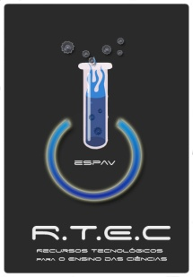


WORKSHOP e-lab: um laboratório online
Sérgio C. Leal^{1,2}, João P. Leal^{1,3}, Horácio Fernandes⁴
¹ Departamento de Química e Bioquímica, FCUL, Lisboa, Portugal
² Escola Secundária Padre António Vieira, Lisboa, Portugal
³ Instituto de Tecnológico Nuclear, ITN, Sacavém, Portugal
⁴ Departamento de Física, IST, Lisboa, Portugal
sergioleal20@gmail.com

Slide 2
e-lab: um laboratório online
Introduction
Students questions seem to disappear along with time.
Students show lack of motivation when learning Science.
The above situation is dependent of:
Classic teaching approach;
Missing contextualization of scientific concepts.

Slide 3
e-lab: um laboratório online
Introduction
A study performed in 2006 [1] suggests that experimental work and new technologies are valuable resources to increase motivation of students in science learning.
The e-lab platform has the above valences.

Slide 4
e-lab: um laboratório online
Objectives
Allow teachers' and students' access to a laboratory where is possible to collect data in real time.
Perform experiments that need expensive material and without concerns with safety precautions.

Slide 5
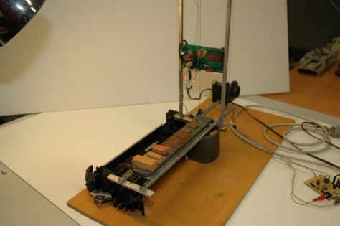
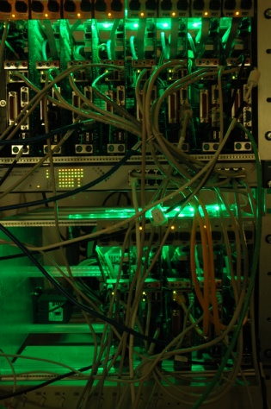
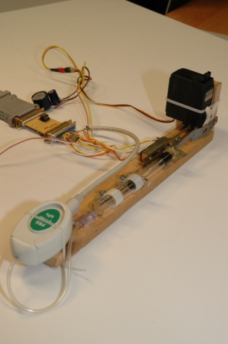
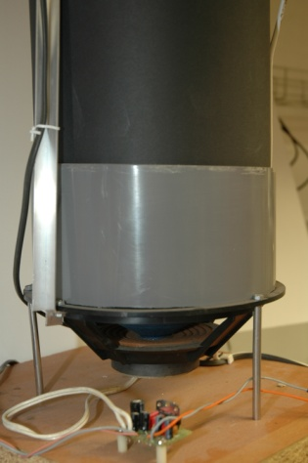
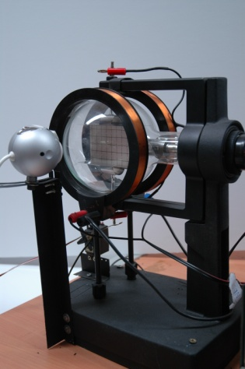
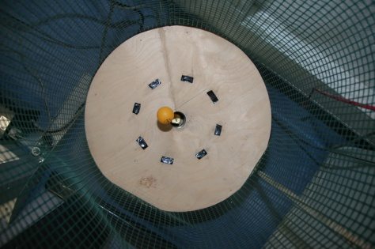
e-lab: um laboratório online
Objectives
e-lab is a platform for science teaching that aims to develop scientific knowledge and motivation on students.

Slide 6
e-lab: um laboratório online
Description – preliminary study
Continuous training 26/09/2009 – 21/11/2009
15 teachers of primary and secondary school of Portugal in Lisbon region
9 sessions of 4 hours (evaluation in the last session)
Developed in Moodle

Slide 7
e-lab: um laboratório online
Description – preliminary study
Introduction to e-lab platform
Tools for data analysis
Exploration of the e-lab in physic and chemistry teaching

Slide 8
e-lab: um laboratório online
Description – preliminary study
Experiments explored by teachers:
determination of gravity value (on Earth);
pressure change with volume (Boyle-Mariotte law);
pressure change with depth (hidrostatic law);
launching data (statistics).

Slide 9
e-lab: um laboratório online
Description – preliminary study
At the end teachers are expected to:
(i) know how to use the e-lab interface;
(ii) know the experiments that already exist;
(iii) have a global vision on the e-lab internal structure and functioning;
(iv) be able to contribute to the improvement of
e-lab interface;
(v) be able to propose others experiments and resources;
(vi) propose and know more scientific resources.

Slide 10
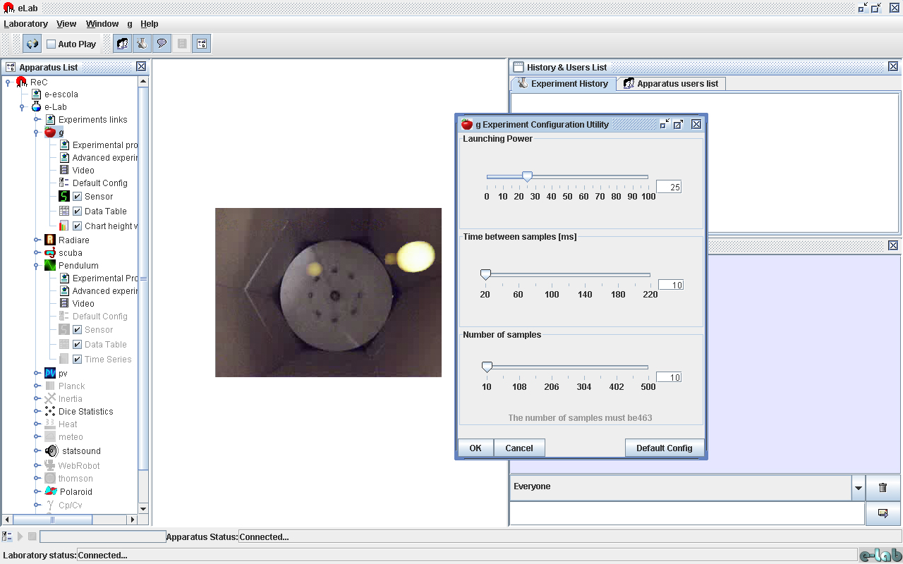
e-lab: um laboratório online
Almost extint interface

Slide 11
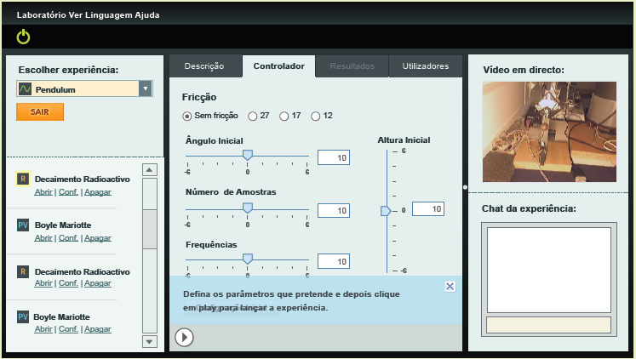
e-lab: um laboratório online
New interface

Slide 12
e-lab: um laboratório online
Conclusion
Enthusiastic inquiry results
The use of experimental work and/or technologies in classroom seems essential to motivate students to scientific areas [1, 3, 4, 5, 6]
We believe that e-lab is a proper tool for experiments data collection using a simple, functional, user-friendly platform with all the necessary resources for students and teachers

Slide 13
e-lab: um laboratório online
Next steps
Perform a larger study
Produce more pedagogical materials to e-lab
Introduce new experiments

Slide 14
e-lab: um laboratório online
Challenge and Suggestions
Use e-lab platform in school
Suggest experiments to the e-lab

Slide 15
e-lab: um laboratório online
Multimedia support
http://www.e-escola.pt/elab.asp
http://moodle.crie.min-edu.pt (disciplina e-lab)
http://elab.ist.utl.pt/rec/index_uk.html
(english version of almost extint e-lab platform)
http://elab.ist.utl.pt/rec/index1.html
(portuguese version of almost extint e-lab platform)
http://elab1.ist.utl.pt/rec.am/Login.faces
(portuguese version of new e-lab platform)

Slide 16
e-lab: um laboratório online
References
[1] Leal, S. C. A química orgânica no ensino secundário: percepções e propostas. MsC. Thesis. Aveiro: Universidade de Aveiro, 2006.
[2] Paiva, J. O fascínio de ser professor. Lisboa: Texto Editores, 2007.
[3] Leal, S. C. & Leal, J. P. Pedagogical Material that Promotes Students Interest in Science. 6th International Conference on Hands-on Science Proceedings, ISBN 978-989-95095-5-9. Costa MF, Darrío BV, Patairiya MK (Eds.); 2009, 27-31 October; Science City, Ahmedabad – India. 2009. pp. 161-164.

Slide 17
e-lab: um laboratório online
References
[4] Leal, S. C. & Leal, J. P. Why are Students not attracted by Physics and Chemistry? EduLearn09 Proceedings, ISBN 978-84-612-9802-0. L. Gómez Chova, D. Martí Belenguer, I. Candel Torres (Eds.); 2009, 6-8 July, International Association of Technology, Education and Development IATED, Valencia. 2009. pp. 4019-4022.
[5] Leal, S. C., Fernandes, H. & Leal, J. P. Laboratório virtual e-lab: uma plataforma de ensino das ciências. XIII Encontro Nacional de Educação em Ciências Proceedings, ISBN 978-989-95831-2-2. Escola Superior de Educação, Instituto Politécnico de Castelo Branco (Eds.); 2009, 24-26 September, Escola Superior de Educação, Instituto Politécnico de Castelo Branco, Castelo Branco. 2009. pp. 1557-1560.

Slide 18
e-lab: um laboratório online
References
[6] Leal, S. C., Leal, J. P. & Fernandes, H. e-lab platform: promoting students interest in science. INTED2010 Proceedings, ISBN 978-84-613-5538-9. L. Gómez Chova, D. Martí Belenguer, I. Candel Torres (Eds.); 2010, 8-10 March, International Association of Technology, Education and Development IATED, Valencia. 2010. pp. 2810-2819.

